Slide 1
WELCOME
TO MY PRESENTATION

Slide 2
Prepared By:
Md. Emon Ali
ID: 171-35-1927
Department Of SWE in Daffodil International University.

Slide 3
PROJECT SUPERVISOR:
Supervised By:
Dr. Md. Asraf Ali
Associate Professor Of SWE in Daffodil University

Slide 4
Presentation Topic:
School Billing System

Slide 5
What is School Billing?
It is a web based application for managing the billing system for the operations in schools. The School Billing System in Project C keeps all record of the Students, Teachers and Staffs working in the institution. The program is run by the administrator who can add, modify, delete, check and find the records according to the need.

Slide 6
SO
How it Works ? ? ?

Slide 7
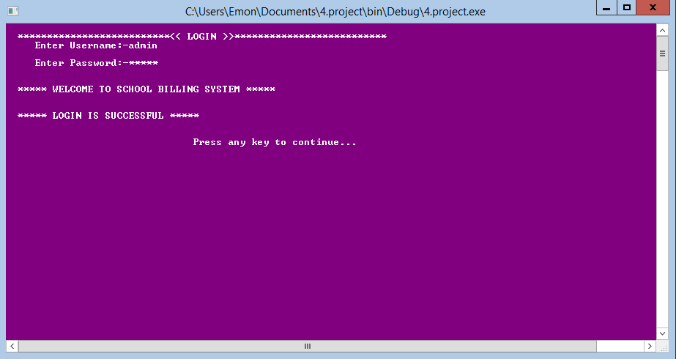
Press Any key

Slide 8
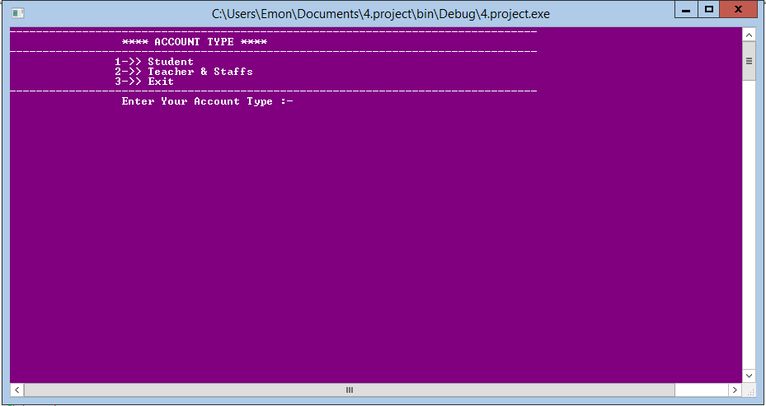
Press1
Press 3
Press 2

Slide 9
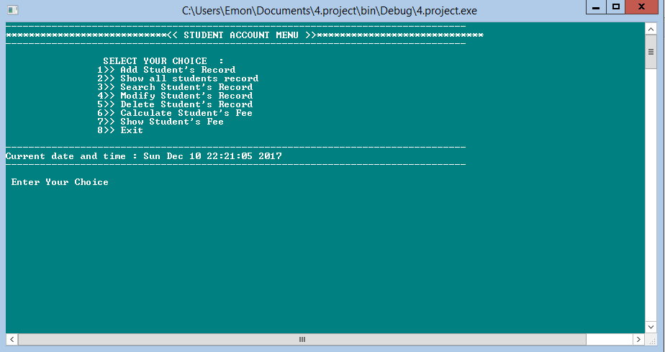
Press 1

Slide 10
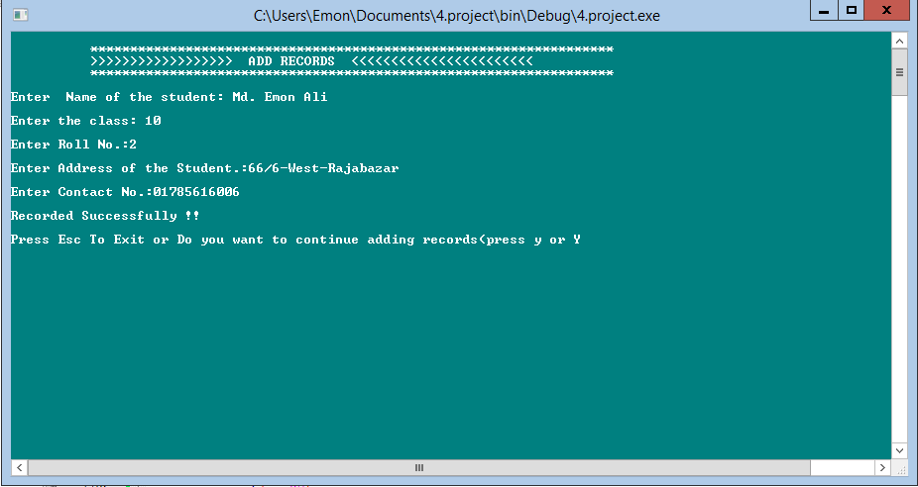
Press Esc

Slide 11
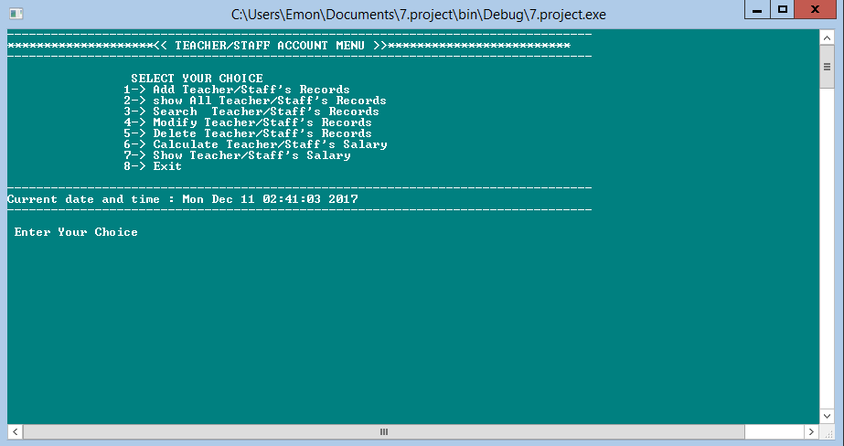
Press 1

Slide 12
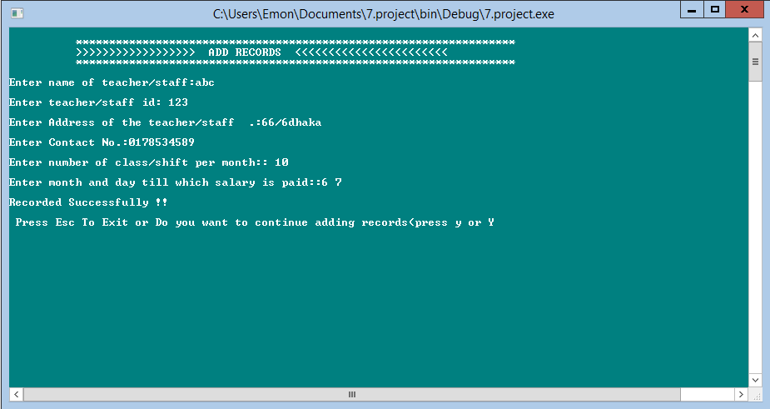
Press Esc

Slide 13
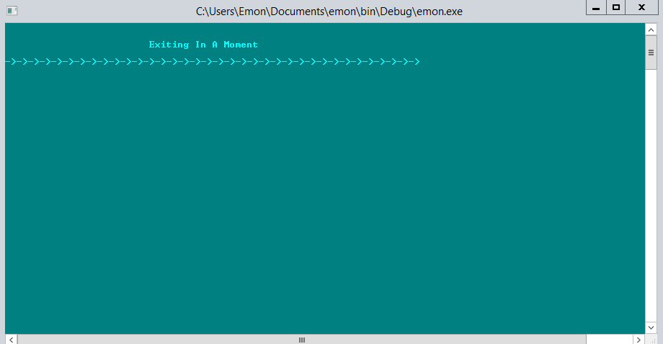

Slide 14


